Slide 1
Linux device driver
Day 12 PPT
-SUBITHRA s

Slide 2
Operating System (OS)
An operating system is a software that manages computer hardware and provides services to applications.
The primary functions of an operating system include process management, memory management, file system management, device management, and user interface management.
The operating system abstracts hardware resources, providing a uniform interface for applications to interact with hardware devices without needing to know the underlying hardware details.
Examples of operating systems include windows, macos, linux, android, ios, and unix-based systems like ubuntu and centos.
The operating system kernel is the core component that directly interacts with hardware and manages system resources. It provides low-level services such as process scheduling, memory allocation, and device drivers.
Operating systems may support multi-tasking, multi-threading, virtual memory, networking, security mechanisms, and other advanced features to support efficient and reliable execution of applications.

Slide 3
Process
A process is an instance of a program that is being executed. It is an independent entity in the operating system's memory, consisting of code, data, and system resources.
Each process has its own address space, which includes the program code, data, stack, and heap. This isolation ensures that processes cannot directly access the memory of other processes.
Processes can communicate with each other using inter-process communication (ipc) mechanisms provided by the operating system, such as pipes, sockets, and shared memory.
Processes are managed by the operating system's kernel, which allocates resources, schedules execution, and ensures process isolation and protection.

Slide 4
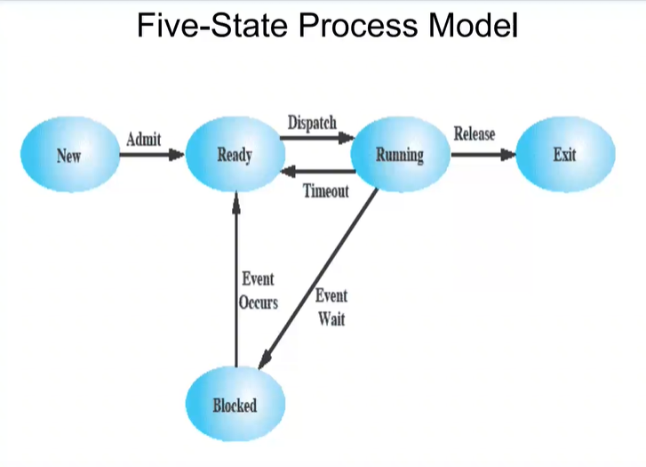

Slide 5
Thread
A thread is the smallest unit of execution within a process. It represents a single sequential flow of control within the process.
Threads within the same process share the same address space, including the program code and data, but each thread has its own stack for local variables and function calls.
Threads allow for concurrent execution within a process, enabling tasks to be performed simultaneously or in parallel.
Threads can communicate with each other through shared memory or synchronization primitives provided by the operating system, such as mutexes, semaphores, and condition variables.
Threads are lightweight compared to processes since they share resources within the same process, and switching between threads typically incurs less overhead than switching between processes.

Slide 6
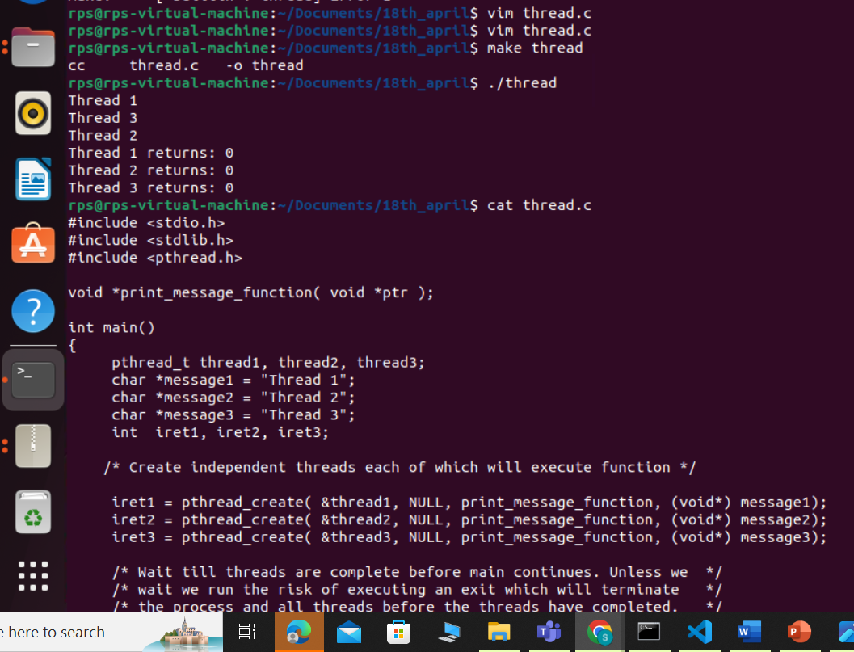
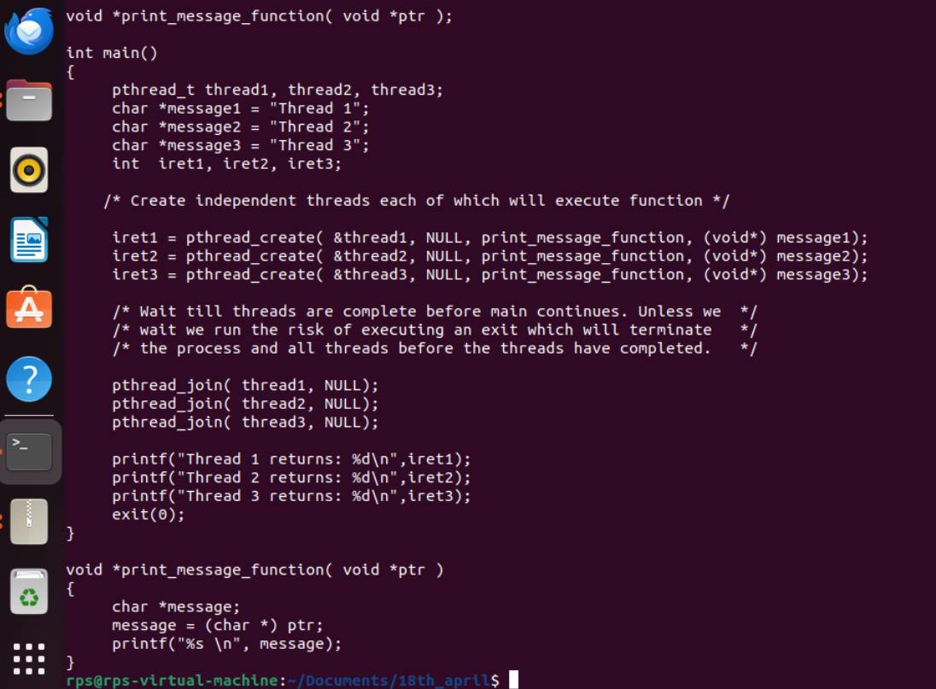
Thread create and join
pthread_create simulates creating a thread by generating a random thread identifier and then immediately calling the start routine function (start_routine) with the provided argument (arg).
pthread_join simulates waiting for the thread to finish by printing a message indicating that it is waiting and then printing another message indicating that the thread has been joined.

Slide 7
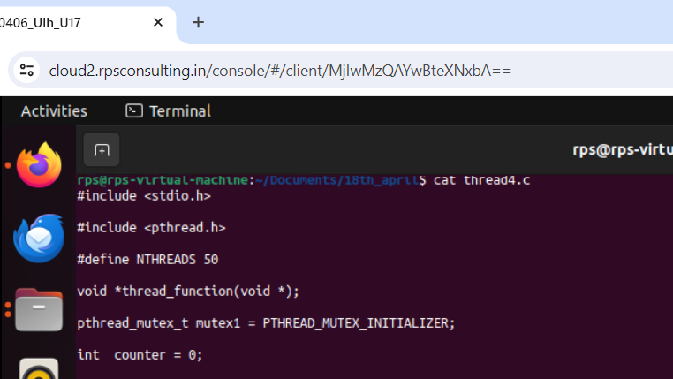
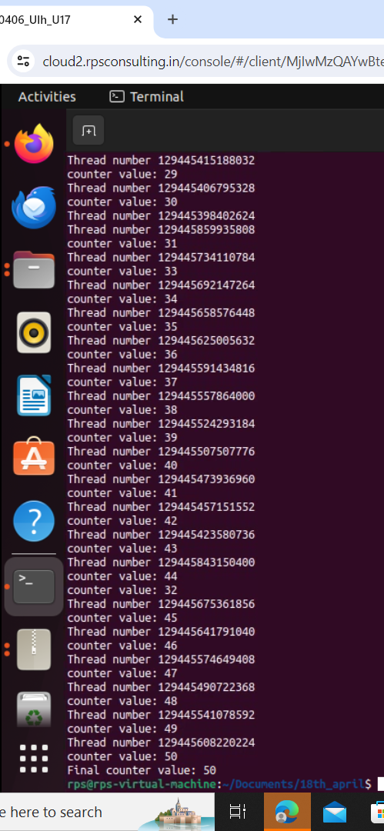
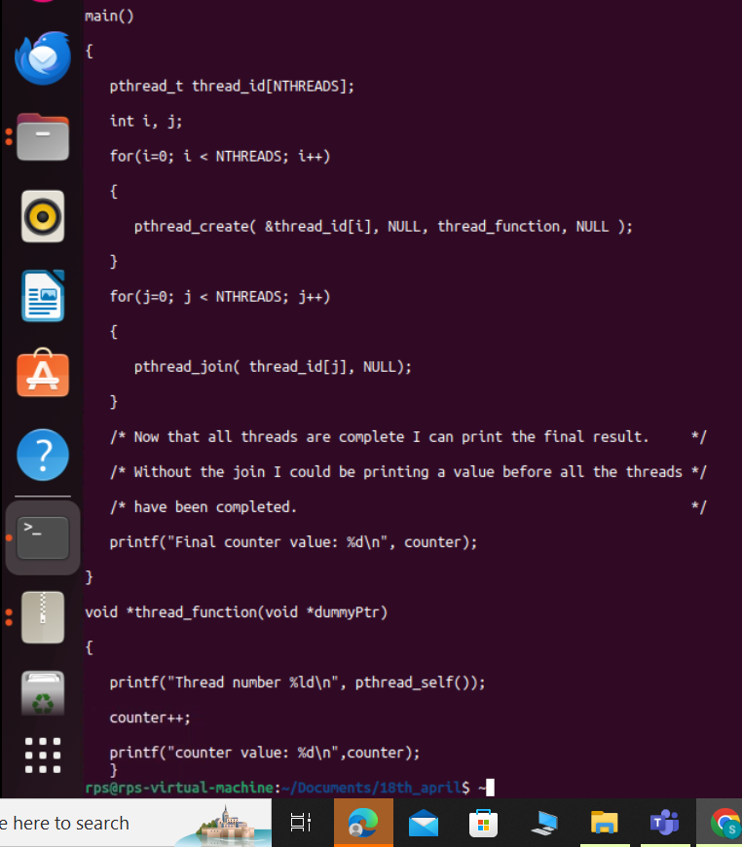
Without mutex
Without using a mutex, multiple threads accessing and modifying shared resources can lead to unsynchronized behavior and data corruption due to race conditions.
Race Conditions: Multiple threads may try to access and modify shared resources simultaneously. Without synchronization mechanisms like mutexes, the order and timing of these operations are unpredictable, leading to race conditions.
Data Corruption: Concurrent access to shared variables without proper synchronization can result in data corruption. For example, if two threads increment a shared counter simultaneously, the final value may not reflect the actual number of increments performed.

Slide 8
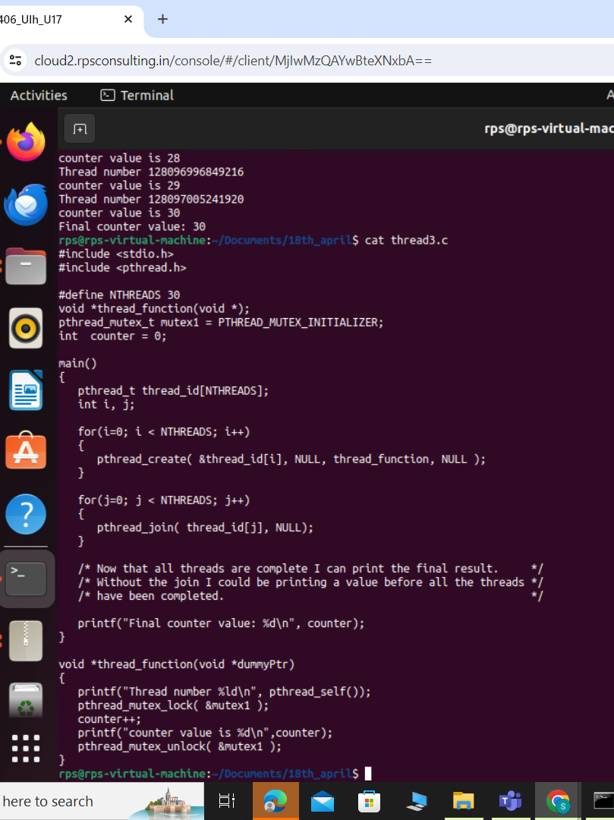
With mutex
void *thread_function(void *dummyPtr): This line defines the thread_function function, which takes a void pointer dummyPtr as an argument
printf("Thread number %ld\n", pthread_self());: This line prints the ID of the current thread. pthread_self() returns the ID of the calling thread. %ld is used to format the thread ID, assuming it's a long integer.
pthread_mutex_lock( &mutex1 );: This line locks the mutex named mutex1. Before modifying the shared variable counter, the thread locks the mutex to ensure exclusive access. If another thread has already locked mutex1, this thread will wait (or block) until the mutex is unlocked by the other thread.
counter++;: This line increments the shared variable counter. Since this operation is now protected by the mutex, only one thread can modify counter at any given time, ensuring that the operation is thread-safe.
pthread_mutex_unlock( &mutex1 );: This line unlocks the mutex mutex1, allowing other threads to acquire it. Once the critical section of code (where counter is being modified) is done, the mutex is released, allowing other threads to access the shared resource.

Slide 9
THANK YOU

